Slide 1
DBMS
E-R MODEL

Slide 2
INTRODUCTION
E-R MODEL IS A HIGH LEVEL CONCEPTUAL DATA MODEL DELOPED BY PETER CHEN IN 1976.
IT IS CRETAED TO FACILITATE DATABASE DESIGN.
IT IS THE GENERALIZATION OF THE EARLIER AVAILABLE COMMERCIAL MODELS LIKE THE HIERARICHAL AND THE NETWORK MODEL.

Slide 3
FEATURES
THE E-R DIAGRAM USED FOR REPREENTING E-R MODEL CAN BE EASILY CONVERTED INTO RELATIONS IN RELATINAL MODEL.
IT PROVIDES AN EASILY UNDERSTOOD PICTORIAL MAP FOR THE DATABASE DESIGN.
IT IS A TOP-DOWN APPROACH TO DATA BASE DESIGN.
IT OFFERS AN EFFECTIVE FRAMEWORK FOR INTEGRATING MULTIPLE APPLICATIONS.

Slide 4
FEATURES
THE E-R MODEL IS USED FOR THE PURPOSE OF GOOD DATABASE DESIGN BY THE DATABASE DEVELOPER SO TO USE THAT DATA MODEL IN VARIOUS DBMS.
IT IS HELPFUL AS A PROBLEM DECOMPOSITION TOOL AS IT SHOWS THE ENTITIES AND THE RELATIONSHIPS BETWEEN THOSE ENTITIES.

Slide 5
BASIC TERMINOLOGIES OF E-R MODEL
ENTITY- DATA OBJECTS ABOUT WHICH INFORMATION CAN BE COLLECTED AND STORED(EXAMPLE: STUDENT,TEACHER).
ATTRIBUTE-PROPERTIES OF AN ENTITY(NAME,SALARY OF EMPLOYEE).
RELATIONSHIP-AN ASSOCIATION AMONG ENTITIES(EXAMPLE:DEPARTMENTS MANAGE ONE OR MORE PROJECTS.).

Slide 6
TYPES OF ATTRIBUTES
SIMPLE ATTRIBUTE: AN ATTRIBUTE THAT CONSIST OF AN SINGLE ATOMOC VALUE. IT CAN NOT BE FURTHER SUBDIVIDED. EXAMPLE: AGE,SALARY ETC.
COMPOSITE ATTRIBUTE: AN ATTRIBUTE THAT CAN BE FURTHER DIVIDED INTO SUB PARTS OR COMPONENTS. EXAMPLE: THE ADDRESS ATTRIBUTE CAN BE COMPOSED OF COMPONENTS LIKE: HOUSE NUMBER, STREET NUMBER,AREA,CITY ETC.

Slide 7
TYPES OF ATTRIBUTES
SINGLE VALUED ATTRIBUTE: A SINGLE VALUED ATTRIBUTE CAN HAVE ONLY A SINGLE VALUE.FOR EXAMPLE: A PERSON CAN HAVE ONE DATE OF BIRTH,AGE ETC. IT CAN BE SIMPLE OR COMPOSITE ATTRIBUTE.
MULTI VALUED ATTRIBUTE: MULTI VALUED ATTRIBUTES CAN HAVE MULTIPLE

Slide 8
TYPES OF ENTITIES
Strong Entity Type:
Strong entity are those entity types which has a key attribute.
The primary key helps in identifying each entity uniquely.
It is represented by a rectangle

Slide 9
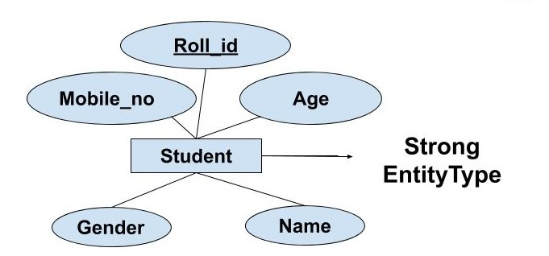
EXAMPLE

Slide 10
WEAK ENTITY
Weak entity type doesn't have a key attribute. Weak entity type can't be identified on its own.
It depends upon some other strong entity for its distinct identity.
This can be understood with a real-life example.
There can be children only if the parent exits. There can be no independent existence of children.
There can be a room only if building exits. There can be no independent existence of a room.

Slide 11
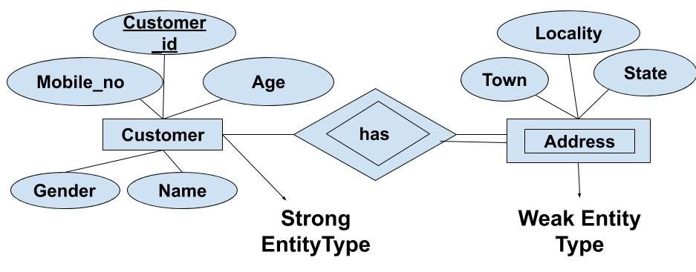
EXAMPLE

